Slide 1
Workbook Expenditures from Gross Profit to EBIT - Cost of Sales (CoS) (Planning)
Internal Use Only
April 2017
EXCEL FILE:

Slide 2
Disclaimer
The content of this workbook has been produced by KPMG Germany/Deal Advisory on the basis of German accounting standards and/or IFRS, as well as considering KPMG Germany’s firm and country requirements, regulations, processes, policies and best practices. Please check your local accounting and other requirements before applying the content.

Slide 3
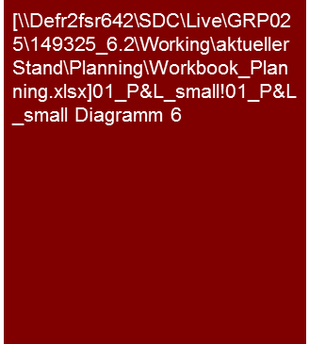
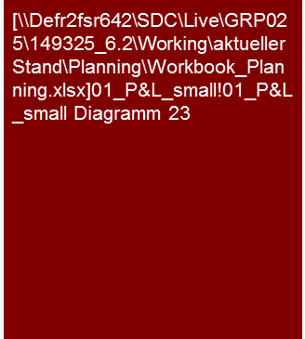
Overview (1/6) – Mission statement
Expenditures from Gross Profit to EBIT Cost of Sales (CoS) (Planning)
Flag: Total Cost Method (TCM) is a commonly used approach in the DACH region. However, other GAAPs may only accept the CoS approach. Please check your local requirements before applying TCM in your analysis.
Tools listed are commonly used in Germany and may differ in other regions.
Mission Statement:
The goal is to assess the plausibility of the planning of costs and profit margins on the basis of the transparency of the major planning assumptions and their consistency to past, market and competitive analyses
Customer situation
Definition/Methodology/Tools of the basis analysis
Buy Side/Sell Side/JV/Turnaround
Expenditures and margin planning as main drivers for the derivation of the cash flow and therefore main drivers for valuations, purchase price determination, assessment of the potential for restructuring
Analysis of the ambitiousness of the planning for negotiations, adjustments of purchase price (e.g. earn outs), internal transactions and tax purposes as well as assessment potential for restructuring
Cost of Sales (CoS): The earnings attained are compared to the expenses required for these.
Definition
Expenditures and corresponding operative profit margins (gross profit, EBITDA, EBIT) are to be determined in accordance with the last audit report or on the basis of the definition of the target’s controlling/management reporting. By applying the definition of the target’s controlling/management reporting a transition to the balanced/audited finance information is assured
Pay attention to comparability of the definition to competitors or market studies (e.g. opex vs. capex)!
Extraction of the depreciation from the function costs is obligatory to be able to determine EBITDA and cash flow
Methodology
Discussions with planning responsible persons
Transparent and consistent linking of the results of the competitive analysis from the past analysis and market and competitive analysis with planning analysis (generally also joint presentation)
Analysis and/or presentation at selected levels (e.g. group, legal entity, segment, profit center, product group, region, etc.) in accordance with the necessity, appropriateness and data situation in the specific case
Concentration on expenses with effect on payment (cash flow), in cases of non-cash expenses assure consistency with balance sheet
Concentration on expenses with significant effect on the development of the margin
Breakdown of the function costs into cost types to the extent that the data situation permits this – see also workbook Expenditures from Gross Profit to EBIT – Total Cost Method (TCM)
Tools
Analysis Toolbox
EBIT and EBIT margin over time
Composition of expenses and expenses ratios
Degree of standardization
Linking of the past and planning as well as the market and competitive analysis
Provision of Analysis Toolbox
Determination and collection of sector-specific KPIs (Benchmarking Project)

Slide 4
Overview (2/6) – Structure of the P&L analysis and corresponding workbooks
Expenditures from Gross Profit to EBIT Cost of Sales (CoS) (Planning)
High level P&L analysis
Workbooks for in-depth analysis – Value Driver Tree
Commentary
Explanation of the major trends (sales growth, profitability in % of sales, significant leaps in individual P&L lines), if necessary supplemented by individual operative KPIs and/or benchmarks; very dependent on business model and sector of the specific company
Purpose:
Planning of our analyses and determination of focus
For reporting purposes: Summary (Big Picture/Exec Summary) of the results of the analysis
Workbook ”Sales and Gross Profit"
The detailed analyses should
Improve the comprehension of the business model and the main drivers in the planning
Show the trend of the economic development (monthly or quarterly as necessary)
Allow a meaningful benchmarking by means of suitable categorization of sales
Market development
Sales
x
Price
Gross profit/ Margin
Trend analysis (with KPIs)
Volume
-
Differentiated according to product groups, customers, regions
Margin (in % of sales)
Costs of materials
According to types of materials
x
Price
EBIT (representing entire P&L)
Volume
-
Analysis of personnel costs in the individual P&L blocks:
Analogous to the personnel cost analysis in the Total Cost Method (TCM) workbook, (FTEs and personnel costs per FTE), only that the relevant personnel costs are not restricted to a single P&L line
Workbook "Expenditures from Gross Profit to EBIT"
Analysis should make cost structure and drivers transparent
The challenge by the Cost of Sales (CoS) is frequently the detailed analysis, due to the fact that the function costs cannot be further broken down according to types of costs. It might be possible to differentiate them according to major parts of costs.
Distribution costs
Each trend analysis, if possible differentiated according to (sub-) types of costs
Expenditures "below gross profit"
Administrative costs
Analysis of the cost structure (fixed vs. variable), benchmarking, cost drivers
Other expenditures (e.g. R&D)
Workbook "Investments“
Depreciation
Analysis of how much depreciation is contained in each P&L line.
Otherwise analogous to Total Cost Method (TCM) workbook

Slide 5
Overview (3/6) – Analysis puzzle
Expenditures from Gross Profit to EBIT Cost of Sales (CoS) (Planning)
Market and competitive analysis^{(a)}
Market
Results of analysis
Core statement/Conclusive valuation
Planned/Actual comparison adherence to budget^{(c)}
Comparison
with
past
Comparison with market expectations
Value drivers
Investments and
Depreciation^{(d)}
Planning analysis expenditures & margins
Analysis of past^{(b)}
Scale effects
LTM
Normal- ization^{(e)}
Comparison
with
peers
Current
trading
Product/Segment/
Regions mix
effects
Cost savings potential & synergies^{(f)}
Peer group
Note: a) See Market Analysis workbook; b) see Expenses (CoS or TCM) workbooks; c) see Planning Process and Adherence to Planning workbook; d) see Investments (Planning) workbook; e) see Normalized Earnings workbook; f) see Synergy Management workbook
Scope of the workbooks

Slide 6
Overview (4/6) – Pitfalls
Expenditures from Gross Profit to EBIT Cost of Sales (CoS) (Planning)
No. | Pitfalls/Lessons learned
 | Comparability: With the analysis of the past and planning as well as the benchmarking of the planning in the market and competitive environment/peer group, the general comparability of the parameters analyzed is to be assured, if necessary by means of adjustments/conversions. Differences may result, for instance, with: The delineation: Differences in financial reporting standards or utilization of accounting options (e.g. presentation as expenses vs. capitalization and depreciation) The information shown: Differing accounting standards or utilization of balancing options or latitude (e.g. reporting as expense vs. capitalization and depreciation, differing realization of sales, etc.) The fundamental design and arrangement of economically identical/similar issues: Various measures for achieving the same economic result (e.g. acquisition vs. leasing/rental, borrowing vs. factoring) A lack of complete comparability (e.g. lack of information about the impact of options, etc. with peers that appear to be significant) is to be mentioned and appropriately recognized (e.g. “only limited validity“).
 | Planning depth: Frequently, the first planning year (budget) is detailed and therefore planned realistically or even conservatively because other processes are based on them (remuneration, metrics, target attainment) and measurement can be made promptly (current trading). Subsequent planning years are generally not included here and are frequently based on a reduced depth of the planning assumptions. They are often planned generally, frequently much “more fancifully” (higher growth, increase in margins,…→ “hockey stick“) (similar to a strategic outlook) and therefore should be viewed more critically.
 | Materiality: With the analysis of the past and planning as well as the benchmarking of the planning in the market and competitive environment/peer group care should be taken that these are only performed for main products/product groups/segments/regions. Furthermore, with the analysis and presentation of the various types of costs, the focus should be on the triggering types of costs of the essential and significant profit/margin changes. No expansive descriptions of non-essential items simply because you know a lot about it!
 | Inflation: Frequently, inflation-based cost increases are not considered in the client’s planning. This is to be scrutinized carefully (e.g. anti-cyclic increases in efficiency) and adjusted if necessary.
 | Intention: Generally a more optimistic picture of the future developmental potential of the target is shown and positive aspects especially emphasized in the framework of sell-side clients. While for buy-side clients planning is scrutinized especially critically and tends to be viewed pessimistically. In both cases, it may come to adjustments of the client planning, scenarios or references to these in our reports.
 | Transition actual to plan: Frequently, the first planning year/budget is not based on audited results from the previous actual year, but rather on a forecast/extrapolation for the previous actual year. Frequently, the audited results and forecast/extrapolation for the previous actual year deviate from one another. Breaches may then occur between the previous actual year and first planning year/budget that may have to be adjusted in case of materiality (adjustment of planning, P&L and balance sheet).
1
2
3
4
5
6

Slide 7






Overview (5/6) – Core issues
Expenditures from Gross Profit to EBIT Cost of Sales (CoS) (Planning)
Core Issue | Specific analysis | Page(s)
Are the planned expenditures, cost/income ratios and the resulting planned profit margins plausible developments from the past? | Comparison of planned margins with the margins attained in the past Analysis of significant drivers (e.g. price and volume effects, portfolio effects, main effects, etc.) and checking of plausible development or assumptions What types of expenditures should contribute to changes in margins (analysis of type of expenditure in % of sales over time per type of expense) Analysis of operational leverage (percentage of fixed vs. variable, fixed cost digression), possible scale effects, etc. over time based on past analysis Are cost reductions (and increases in margins) based on corresponding measures? Have these measures already been decided upon/approved? Transition of the previous actual year to planning year(s) – e.g. Waterfall Chart (Link to Sales & Gross Profit workbook, Normalized Earnings workbook) | 9 – 15
2. Are the planned types of expenditures and the resulting margins consistent with the market expectation and competitors? | Compare expense planning (e.g. personnel costs per FTE, in % of sales and similar) as well as resulting margins (EBITDA, EBIT margins) to market studies, analyst expectations, KPIs from peer group companies (benchmarking) Note: pay attention to uniform definition and if necessary balancing (Opex vs. Capex) of costs as well as profit margins with peers and the companies! Identify, analyze and justify explanation for possible deviations to market expectation (e.g. balancing, leasing, scale effects, etc.) | 16
Does the current trading/LTM or the current forecast support the cost and profit planning? | Compare current trading (if necessary, extrapolation for entire year) or current forecast with costs and profit margin planning | 17 - 19
Have the distribution costs been plausibly planned? | Analysis of relationship to sales over time Analysis of consistency of the assumptions for sales and distribution costs planning (e.g. primary advertising measures with sales planning assumed,…) Analysis of the cost increases of the individual items Analysis of the composition (link to Total Cost Method (TCM) analysis) | 20
360° CQ
360° CQ
360° CQ

Slide 8
Overview (6/6) – Core issues
Expenditures from Gross Profit to EBIT Cost of Sales (CoS) (Planning)
Core Issue | Specific analysis | Page(s)
Have the research and development costs been plausibly planned? | Analysis of relationship to sales over time Analysis of consistency of the assumptions for sales and R&D planning (e.g. launch of new products with sales planning assumed,…) Analysis of the cost increases of the individual items Analysis of the composition (link to Total Cost Method (TCM) analysis) | 21
Have the administrative costs been plausibly planned? | Analysis of the cost increases of the individual items Analysis of the composition (link to Total Cost Method (TCM) analysis) Were the fixed/jump-fixed character of the administrative costs normally properly reflected (scale effects, fixed cost digression, etc.)? | 22
Has other operating result been plausibly planned? | Analysis of composition of other operating result Analysis of cost increases of the individual items Has the fixed/stepped character of the other expenses been appropriately reflected (scale effects, fixed cost digression, etc.)? Analysis of earnings, especially if sales-dependent or special issues e.g. release of provisions, liquidation of special items (no cash flow effect, Assure consistency with balance sheet planning!) etc. | 23
Has depreciation (within the function costs) been plausibly planned? | Extraction of the depreciation from the functional costs to be able to determine EBITDA and cash flow Analysis of differences in depreciation as of commercial and tax balance Assure that depreciation was considered in the same amount in the development of the fixed assets to avoid cash flow effect Simulation for existing fixed assets Depreciation planning for investments in the planning period on the basis of typical or useful lives applied to date No cash flow effect, but relevant for correct derivation of taxes | 24 - 27
360° CQ

Slide 9
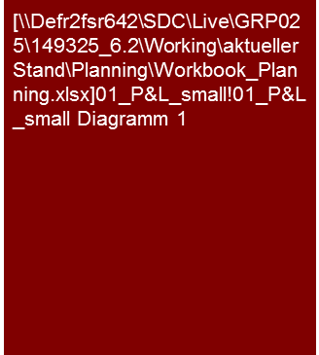
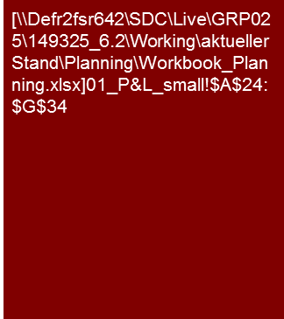
1. Are the planned expenditures, cost ratios and the resulting planned profit margins plausible developments from the past? (1/6)
Expenditures from Gross Profit to EBIT Cost of Sales (CoS) (Planning)
The XXX AG planning reflects a distinct increase of the gross profit margin from x% to y% caused by XXX.
This should also lead to an increase of the EBIT margin from x% to y% in the planning period.
Considering the results achieved in the past, we consider the XXX AG planning to be ambitious.
Operating plan XXX AG
Operating plan
xxx
Actual
Plan
Tools
Excel analysis

Slide 10
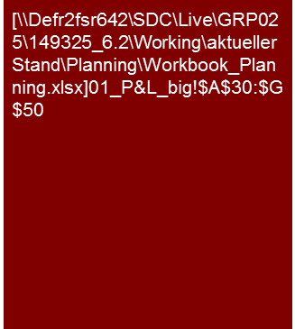
1. Are the planned expenditures, cost ratios and the resulting planned profit margins plausible developments from the past? (2/6)
Expenditures from Gross Profit to EBIT Cost of Sales (CoS) (Planning)
Alternative
The XXX AG planning reflects a distinct increase of the gross profit margin from x% to y% caused by XXX.
This should also lead to an increase of the EBIT margin from x% to y% in the planning period.
Considering the results achieved in the past, we consider the XXX AG planning to be ambitious.
Profit and loss statement
The XXX results in an increase of the gross profit margin in the planning period. XXX
The increase of the other operating income in 2015 is caused by XXX
1
2
Highlight material effects (circle, numerate, etc.)
Tools
Excel analysis

Slide 11
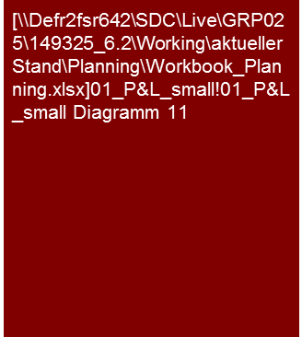
1. Are the planned expenditures, cost ratios and the resulting planned profit margins plausible developments from the past? (3/6)
Expenditures from Gross Profit to EBIT Cost of Sales (CoS) (Planning)
The XXX AG expects its EBIT to increase by over 50% to €13 million In the planning period.
The material causes for this are expected scale effects and the improvement of purchasing conditions for XXX.
In view of the results attained in the past, we consider the expected increase in profits to be ambitious.
EBIT and EBIT margin over time
Development of EBIT margin
The EBIT should be increased from €8.5 million in 2012 to €13 million in 2015 in the course of planning.
Some major causes for the expected profit increase are scale effects and the improvement of procurement conditions. Increases in collective bargaining in personnel costs as well as the expected price reductions for product X have a compensatory impact.
Overall, an improvement of the EBIT margin is expected from 15.2% in 2012 to 19.4% at the end of the planning period, whereby the EBIT margin of 2012 represents the highest EBIT margin ever attained in the history of XXX AG.
The expected scale effects are primarily expected in XXX. They are to be achieved through XXX measures.
[.... details about improvements in procurement conditions ....]
[.... details about collective tariffs increase ....]
[.... details about price reduction of product X ....]
Actual
Plan
Change in EBIT in the planning period
Presentation of essential elements in the bridge. If applicable, presentation across the entire slide with a copy below for majority of essential elements
Tools
Excel analysis

Slide 12

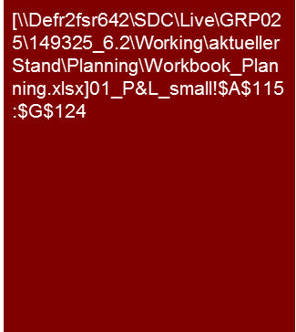
1. Are the planned expenditures, cost ratios and the resulting planned profit margins plausible developments from the past? (4/6)
Expenditures from Gross Profit to EBIT Cost of Sales (CoS) (Planning)
The expected improvement of the EBIT margin in the planning period should primarily be attained by a reduction of the cost of goods sold ratio.
A package of measures has been developed to that end and the implementation initiated.
If applicable estimation realistic/ambitious/plausible/ reproducible…
Change of EBIT margin compared to previous year
Change of EBIT margin
The expected increase of the EBIT margin in the planning period is primarily attributable to a decrease in the cost of sales ratio.
The expected improvement of the cost of sales ratio is caused by XXX
The administration costs initially increase disproportionally in the course of planning compared to sales. In 2015, however, a reduction of the administration costs ratio should be attained by XXX.
Actual
Plan
Tools
Excel analysis

Slide 13

1. Are the planned expenditures, cost ratios and the resulting planned profit margins plausible developments from the past? (4/6)
Expenditures from Gross Profit to EBIT Cost of Sales (CoS) (Planning)
Alternative presentation:
Change of the gross profit margin instead of costs of sales ratio
The expected improvement of the EBIT margin in the planning period should primarily be attained by an improvement of gross profit margin.
A package of measures has been developed to that end and the implementation initiated.
If applicable estimation realistic/ambitious/plausible/ reproducible…
Change of EBIT margin compared to previous year
Change of EBIT margin
The expected increase of the EBIT margin in the planning period is primarily attributable to the a decrease in the cost of materials ratio
The expected improvement of the gross profit margin is caused by XXX
The administration costs initially increase disproportionally in the course of planning compared to sales. In 2015, however, a reduction of the administration costs ratio should be attained by XXX.
Actual
Plan
Tools
Excel analysis

Slide 14

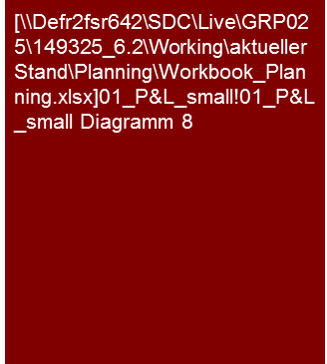
1. Are the planned expenditures, cost ratios and the resulting planned profit margins plausible developments from the past? (5/6)
Expenditures from Gross Profit to EBIT Cost of Sales (CoS) (Planning)
The expenditures of the XXX AG are primarily for cost of sales.
A shift from external performance to own performance is assumed in the course of planning.
This appears plausible in view of the strategic reorientation approved.
Composition of expenditures
Development of the types of expenses and cost ratios
Costs of goods sold are XXX due to …..The increase in the costs of goods sold is justified by XXX.
The selling expenses primarily originate from XXX. The increase of selling expenses is caused by XXX.
The planning of COGS is based on XXX
[.... other operating result 1 sentence (due to subordinate importance) ....]
[..... depreciation 1 sentence (due to subordinate importance) and reference to explanations Capex & depreciation (see Investments workbook) ....]
Actual
Plan
Development of the cost/income ratios
Actual
Plan
These should be analyzed and presented separately (compositions, development, etc.) in cases of major changes of individual types of expenses with impacts on margins.
Tools
Excel analysis

Slide 15

1. Are the planned expenditures, cost ratios and the resulting planned profit margins plausible developments from the past? (6/6)
Expenditures from Gross Profit to EBIT Cost of Sales (CoS) (Planning)
The major portion of the intended cost reductions have been based on measures.
With regard to the cost reduction measures, the major portion are for XXX.
Cost reduction measures
Measures planned
60% of the cost reductions considered in the planning are based on measures. For the remaining 40 %, it is intended to develop measures in the framework of XXX by YYY.
The cost reduction measures approved to date primarily contain a successive reduction of the personnel by XXX with a cost reduction effect of €XX million in the planning period. Furthermore, by means of renegotiating with vendors, savings of €YY million should be attained.
[...description of measure 1 (length corresponds to importance) ...]
[...description of measure 2 (length corresponds to importance) ...]
[...description of measure 3 (length corresponds to importance) ...]
Tools
Excel analysis

Slide 16
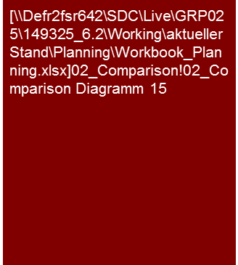

2. Are the planned types of function costs and the resulting margins consistent with the market expectations?
Expenditures from Gross Profit to EBIT Cost of Sales (CoS) (Planning)
The planned EBIT margin of the XXX AG is higher than that of the competitors’ average.
The expected development of the EBIT margin in the planning period shows a comparative trend for the competitors.
The margin expectation lies above…, by approx. x %-points, also above the average expectations of the analysts for the XXX AG.
Based on the statements above, we consider the planned EBIT margin of the XXX AG to be ambitious/ optimistic/realistic/plausible/ conservative/cautious/….
EBIT margin in comparison to peer group
Competitors of the XXX AG show an EBIT margin in a range of X% to Y%. The expected margin for the XXX AG is within this range, above the average. This has already been the case in the past.
The reasons for the above-average margin of the XXX AG compared to the competition are XXX
Increasing margins are expected for all the competitors in the future. This coincides with the expectations of the XXX AG
XXX
Analysts expect on average a, for the most part, constant EBIT margin of 16% for the XXX AG and therefore below the margin expectations of the XXX AG.
The expectations of the analysts with regard to the amount and trend of the EBIT margin are, however, not uniform. The margin expectations of the analysts range from X-Y %. This means in some cases rising margins and, in other cases, falling margins are expected.
The reasons for the heterogeneity of the analysts predictions are the differing expectations with regard to XXX
EBIT margin in comparison to analysts' expectations
Tools
Excel analysis

Slide 17
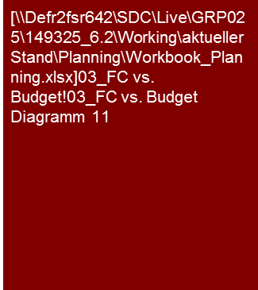
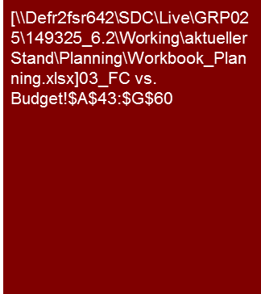
3. Does the current trading/LTM or the current forecast support the cost and profit planning? (1/3)
Expenditures from Gross Profit to EBIT Cost of Sales (CoS) (Planning)
In view of the current business development, the 2013 budget appears to be very ambitious.
The current forecast reflects the results that were below the budget for 2013.
No consequences are expected for the other planning years.
Comparison forecast vs. budget
Current business development
The current business development in the first half of 2013 is below the expectations of the XXX AG. This is primarily due to XXX.
The current business development that is below expectations is also reflected in the adjusted forecast, which is below the budget. The sales expected is now €x.x million or ca. X% and the EBIT ca. €x.x million or ca. X% below budget.
In the forecast of the EBITDA, it should be noted that along with the business development, there are personnel costs above expectations due to the early conclusion of the collective bargaining agreement and encumbrances from the litigation XXX.
The management of XXX AG does not expect any consequences for the planning years 2014 and 2015 to result from the failure to meet the budget in 2013. We agree to this estimation on the basis of the information provided to us and with the analyses we performed.
Tools
Excel analysis

Slide 18
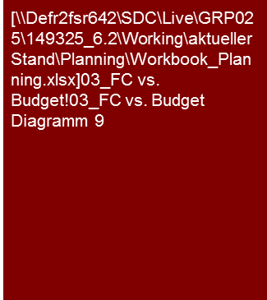

3. Does the current trading/LTM or the current forecast support the cost and profit planning? (2/3)
Expenditures from Gross Profit to EBIT Cost of Sales (CoS) (Planning)
On EBITDA level budget 2013 is supported by current forecast, while EBIT is adjusted upwards in the forecast compared to budget due to lower than expected depreciation.
Comparison forecast vs. budget (absolute)
The expected EBITDA and the expected EBITDA margin for the 2013 forecast are slightly above the budgeted value. The reason for this is XXX.
According to the management and our analyses, these effects do not have any consequences for the subsequent planning years.
The EBIT for forecast 2013 is, with €X million ca. €X million above the budgeted value of €X million.
The EBIT margin of the forecast 2013 is, with 17.7% ca. 0.8%points above the budgeted value of 16.9%.
The primary reason for this, along with the EBITDA margin that is slightly above expectations, is that the depreciation is lower than budgeted. These were caused by XXX.
As a result of the effects described we now expect that the depreciation for the subsequent planning years will be lower. We/The management of the XXX AG have adjusted the planning appropriately.
Comparison forecast vs. budget (margin)
Tools
Excel analysis

Slide 19
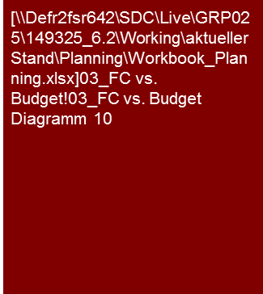
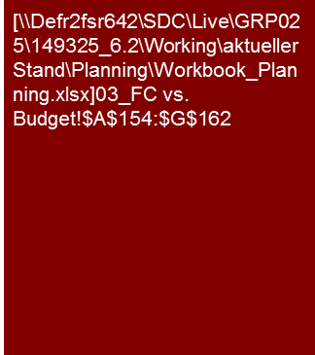
3. Does the current trading/LTM or the current forecast support the cost and profit planning? (3/3)
Expenditures from Gross Profit to EBIT Cost of Sales (CoS) (Planning)
The XXX AG already has ca. two-thirds of the budget for 2013 in the first half year. The reason for this is the high percentage of the Easter business on the entire annual success. The degree of budget attained for the first half year is comparable to the figure of the previous year.
On the basis of the current profit situation, it is expected that the 2013 budget will be attained.
YTD June 2013
Description
xxx
Tools
Excel analysis

Slide 20
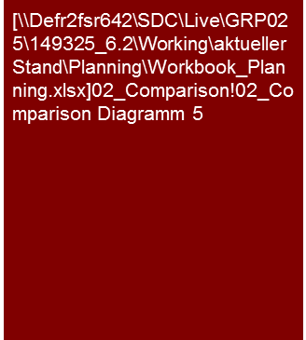
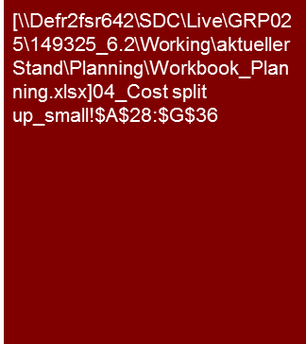
4. Have the distribution costs been plausibly planned?
Expenditures from Gross Profit to EBIT Cost of Sales (CoS) (Planning)
The planned selling expenses of the XXX AG are, as in the past, below the average of the competition.
In view of this we consider the planning of the XXX AG to be ambitious/optimistic/ realistic/plausible/ conservative/cautious/….
Description
xxx
Distribution rate in comparison to peer group
Actual
Plan
Perform analogously to detailed analyses for other function costs, if significant and reasonable
Tools
Excel analysis

Slide 21
5. Have the research and development costs been plausibly planned?
Expenditures from Gross Profit to EBIT Cost of Sales (CoS) (Planning)
The planned research and development costs of the XXX AG are, as in the past, below the average of the competition.
In view of this we consider the planning of the XXX AG to be ambitious/optimistic/ realistic/plausible/ conservative/cautious/….
xxx
xxx
xxx
e.g. List of the major development projects with corresponding cost planning, time of the launch, etc.
xxx
Perform analogously to detailed analyses for other function costs, if significant and reasonable
Tools
Excel analysis

Slide 22
6. Have the administrative costs been plausibly planned?
Expenditures from Gross Profit to EBIT Cost of Sales (CoS) (Planning)
The planned administrative costs of the XXX AG are, as in the past, below the average of the competition.
In view of this we consider the planning of the XXX AG to be ambitious/optimistic/ realistic/plausible/ conservative/cautious/….
xxx
xxx
xxx
xxx
Perform analogously to detailed analyses for other function costs, if significant and reasonable
Tools
Excel analysis

Slide 23
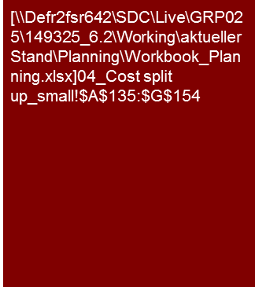
7. Has other operating result been plausibly planned?
Expenditures from Gross Profit to EBIT Cost of Sales (CoS) (Planning)
The other operating result is primarily influenced by the development of XXX and YYY.
The other operating result is primarily due to XXX and YYY. As a result of scale effects the increase of operating expenses is below the increase of net sales in the course of planning.
Explanations on the material individual items and development in the planning period
Explanations for KPIs or dependencies on individual items from other parameters.
Choice of parameters for major expenses on the basis of specific drivers, usually sales or employees
Perform analogously to detailed analyses for other function costs, if significant and reasonable
Tools
Excel analysis

Slide 24
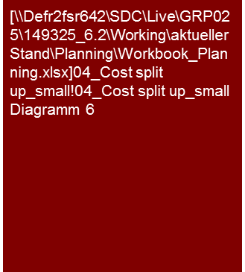
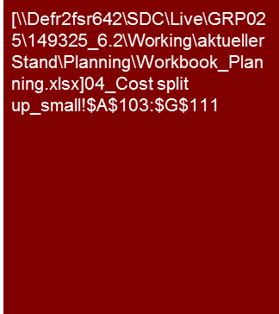
8. Has depreciation (within the function costs) been plausibly planned? (1/3)
Expenditures from Gross Profit to EBIT Cost of Sales (CoS) (Planning)
The XXX AG plans to expand investments in the planning period to reduce the existing investment backlog. Depreciation increases respectively in the course of the planning.
We consider the investment and depreciation planning to be XXX
Depreciation and investments over time
XXX AG expects a significant increase of the investments above the level of depreciation/average investment in the past, as a result of the successive reduction of the investment backlog. These are primarily for XXX.
As a result of the investment activity the assets increase by ca. X% in the planning period.
The investments are primarily in XXX. They are above the level of depreciation/average investment in the past as a result of the successive reduction of the investment backlog.
[.... expansion vs. replacement investments .....]
[.... Additional explanations of investments ...]
[.... explanations of investments, depreciation method and assumed useful life ....]
[... Reproduction of complete investment cycle? Length of planning horizon? Transition to sustainable result → s. workbook Sustainable Result ...]
The depreciation increased slightly in the course of planning as a result of the investment sum being higher than depreciation.
Due to the high assumed useful life of the planned expansion investments the depreciation ratio increased only slightly compared to the investment ratio.
[.... explanations of depreciation and investment rate (investments in % of sales ....)]
Actual
Plan
Note: (a) Depreciation ratio = Depreciation/Sales
(b) Investment ratio = Investments/Sales
Tools
Excel analysis

Slide 25
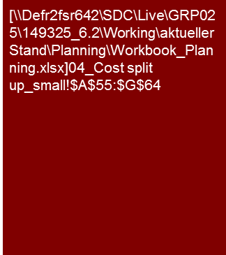
8. Has depreciation (within the function costs) been plausibly planned? (1/3)
Expenditures from Gross Profit to EBIT Cost of Sales (CoS) (Planning)
Alternative presentation:
Depreciation as part of functional costs instead of change in fixed assets
The XXX AG plans to expand investments in the planning period to reduce the existing investment backlog. Depreciation increases respectively in the course of the planning.
We consider the investment and depreciation planning to be XXX
Depreciation and investments over time
XXX AG expects a significant increase of the investments above the level of depreciation/average investment in the past, as a result of the successive reduction of the investment backlog. These are primarily for XXX.
As a result of the investment activity the assets increase by ca. X% in the planning period.
The investments are primarily in XXX. They are above the level of depreciation/average investment in the past as a result of the successive reduction of the investment backlog.
[.... expansion vs. replacement investments .....]
[.... Additional explanations of investments ...]
[.... explanations of investments, depreciation method and assumed useful life ....]
[... Reproduction of complete investment cycle? Length of planning horizon? Transition to sustainable result → s. workbook Sustainable Result ...]
The depreciation increased slightly in the course of planning as a result of the investment sum being higher than depreciation.
Due to the high assumed useful life of the planned expansion investments the depreciation ratio increased only slightly compared to the investment ratio.
[.... explanations of depreciation and investment rate (investments in % of sales ....)]
Actual
Plan
Note: (a) Depreciation ratio = Depreciation/Sales
(b) Investment ratio = Investments/Sales
Tools
Excel analysis
If applicable combined presentation with depreciation as presented in workbook Investments

Slide 26
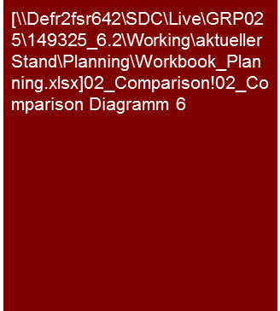

8. Has depreciation (within the function costs) been plausibly planned? (2/3)
Expenditures from Gross Profit to EBIT Cost of Sales (CoS) (Planning)
Volume and development of the depreciation and investment ratio of the XXX AG are comparable to that of competitors.
Based on these statements/data/assumptions, we consider the investment and depreciation planning of the XXX AG to be ambitious/optimistic/ realistic/plausible/ conservative/cautious/….
Depreciation ratio in comparison to peer group
Explanation of depreciation and investment compared to competition XXX if applicable explanation of differences in balancing (Opex vs. Capex), financing (purchase vs. lease/rental), etc.
Investment ratio in comparison to peer group
Tools
Excel analysis

Slide 27

8. Has depreciation (within the function costs) been plausibly planned? (3/3)
Expenditures from Gross Profit to EBIT Cost of Sales (CoS) (Planning)
Volume and development of the depreciation and investment rate of the XXX AG are comparable to that of analysts’ expectations.
Based on these statements/data/assumptions, we consider the investment and depreciation planning of the XXX AG to be ambitious/optimistic/ realistic/plausible/ conservative/cautious/….
Investment rate in comparison to analysts' expectations
XXX
Tools
Excel analysis

Slide 28
© 2017 KPMG International Cooperative (“KPMG International”). KPMG International provides no client services and is a Swiss entity with which the independent member firms of the KPMG network are affiliated.

